Slide 1

Dublin Little League Scorekeeper Meeting
February 21, 2024 @ 7 pm

Slide 2
Thank you for Scorekeeping
Dublin Little League is 100% volunteer based. Without volunteer support we would not be able to function as a league.
Don’t forget… we are doing this for the kids.
Meeting Agenda:
  Update on changes to the scorekeeper goal (new and experienced scorekeepers)
  Provide training to new scorekeepers on how to use game changer

Slide 3
Game Changer Update
As long as you are scorekeeping a “League scheduled Game” in the system both teams will get the stats updates for the game
Do not have two people keep score for a single a game this year!
Home Team is responsible for keeping score

Slide 4
Upload Results
Reminder the home team is responsible for uploading the results on the Dublin little league website.
Please upload within 24 hour of the end of the game.
For AA and above this is how the standings for playoffs is determined
Instructions for how to do this are in the appendix of this presentation.

Slide 5
Updated Local Rules* for 2024
The League had rules meetings with all the coaches to inform them of the changes.
Added a Code of Conduct
Game Start Time clarified
Last inning declaration clarified
Please read over the DLL Local Rules* (not all sections apply to your division!) and the Summary Grid in detail - many managers only focus on the Summary Grid and neglect the DLL Local Rules and Little League International Rules (LLI) - DOWNLOAD THE FREE LLI RULEBOOK APP!
*previously known as the House Rules

Slide 6
Game Coordinator (Visitor Scorekeeper)
The Visiting Scorekeeper is required to act as the “Game Coordinator” when there are no Adult umpires at a game.
Rule 9.03(d) from Little League International If no adult umpire is available for a game, and non-adult umpires are used exclusively for that game, the local Little League must assign an adult as Game Coordinator, or the game cannot be played. The Game Coordinator must not be a manager or coach of either team in the game…
Game Coordinator Responsibilities
  Be present for the entire game
  Stop play for inclement weather or unsafe playing conditions
  Attend pre-game meeting with umpire and managers
  Oversee conduct of all players, manager, coaches & umpires
    This can include ejections of a player, manager, coach, and/or spectator.
Game Coordinator Cannot:
  Eject an umpire
  Over-rule any umpire decision
  Participate in an appeal

Slide 7
Our job is to keep everyone in the game, but there are times when a manager, coach, or player steps over the line and brings ejection upon him or herself. Examples…
Use of tobacco (in any form) or alcohol
Use of electronic communication with personnel during the game
Profanity (directed at an umpire or audible f-bomb)
Personal insults directed at an umpire; especially the “Y” word (“You ____!”)
Physical contact.
Refusal to stop arguing & further delaying the game after umpire has provided adequate opportunity for discussion
Leaving position to argue balls & strikes; arguing balls & strikes from the dugout (“sniper fire”)
Persistently instructing players to infringe the rules (unsportsmanlike conduct).
Persistently arguing or objecting to the decisions of an umpire.
Intimidating a youth umpire.
Histrionic gestures while expressing disagreement with an umpire’s decision
Throwing equipment in disgust over an umpire’s call
Anything else that the umpire deems inappropriate (Rule 9.03(4)).

Slide 8


Additional Notes
Tablets at Fallon Baseball fields if you want to use them
  Don’t take the chargers.
  Make sure they are locked up
Fallon baseball fields have WIFI to help with game streaming. No other fields currently have WIFI.
Please let the league know if your umpires do not show up.
Help the umpire with time tracking
Game changer website has 40 minutes of tutorials you can take if you still have questions after this clinic.
https://gc.com/home/gcu/scorekeeping-baseball-softball
Game Changer Classic is still available for download. Don’t download classic.

Slide 9
Single A Baseball scorekeeper special rules
4 outfield positions
  While scoring a game you can change this in the settings area.
Machine Pitch
  Record 2 strikes then 2 balls. If the 5th pitch is a strikeout record a strikeout like normal, if it is a foul just record a foul ball. Use the count to keep track of the number of pitches (5 for machine pitch)
Kid Pitch and Machine Pitch
  Create a placeholder player that represents the coach and sub him or her into the game for the pitcher each time that he or she must come in to complete an at-bat. Once this placeholder is subbed in, you can use the Override feature within the Game Menu to reset the pitch count (or just the number of balls) for the at-bat. This override feature will not affect the pitch count of the player. However, once the at-bat is complete, you must sub the original pitcher back into the game.

Slide 10
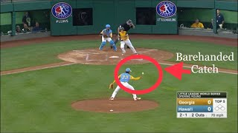

Slide 11
Appendix

Slide 12
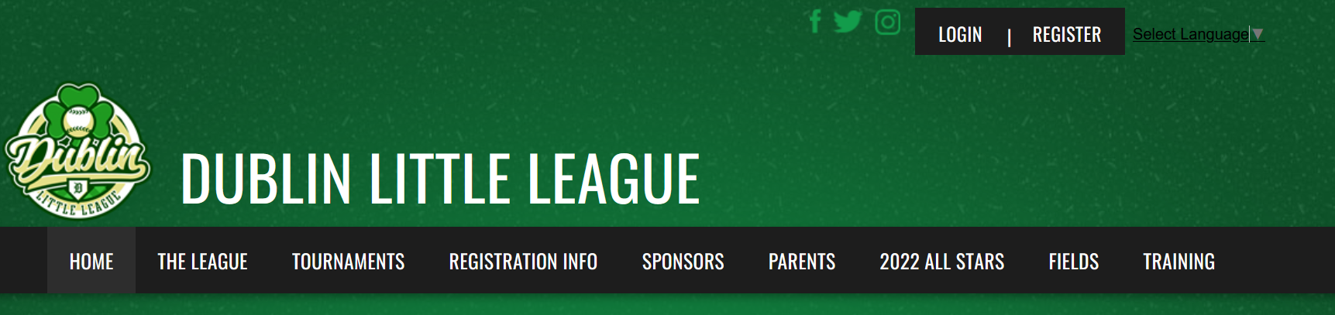
How to record results on Dublin Little League Website
1. Go to the Dublinll.org website
2. Login with the same login you used to register your player(s)

Slide 13
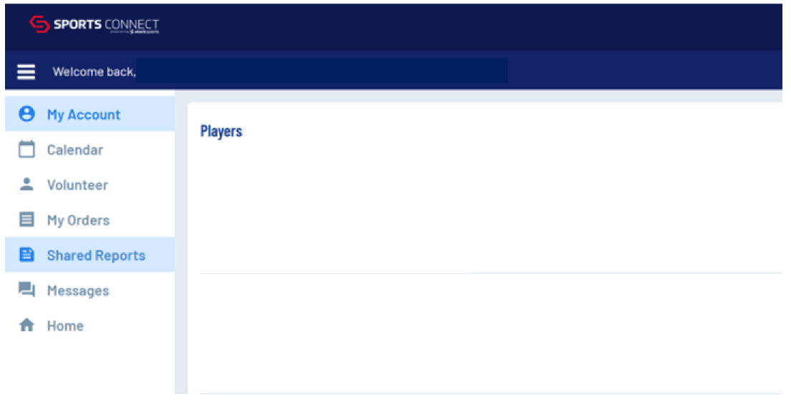
How to record results on Dublin Little League Website
3. Click on ""Home" to get back to the main screen, where you will see a new option on the upper ribbon for "Team Central" as well as a new options on the top left for "schedule."

Slide 14
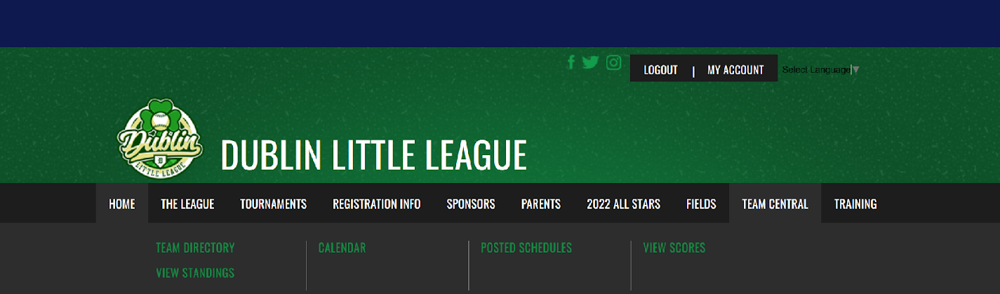
How to record results on Dublin Little League Website
4. Put your mouse over “Team Central” a drop down will appear then click on “Team Director”

Slide 15
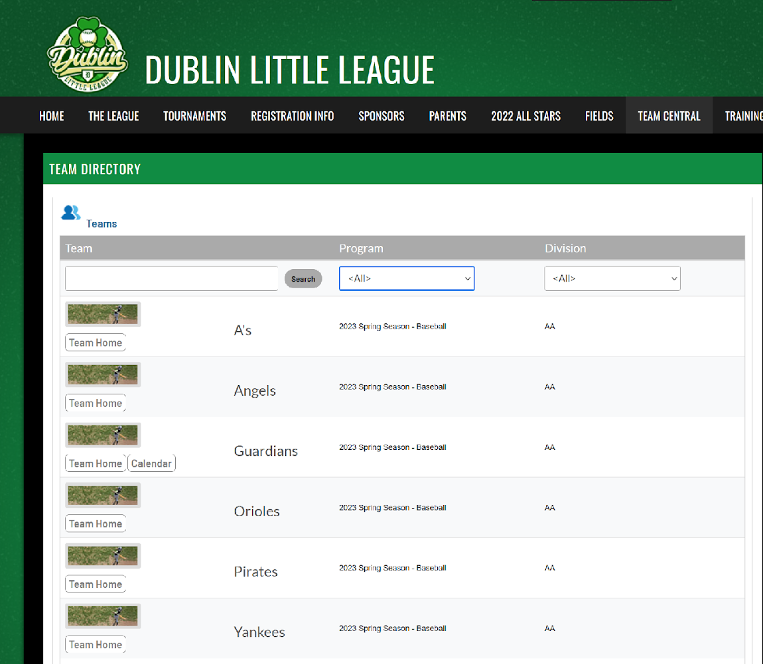
How to record results on Dublin Little League Website
5. Find your team and if you have the right access you should see “Calendar” click on that. There are filters to help with finding your team.

Slide 16
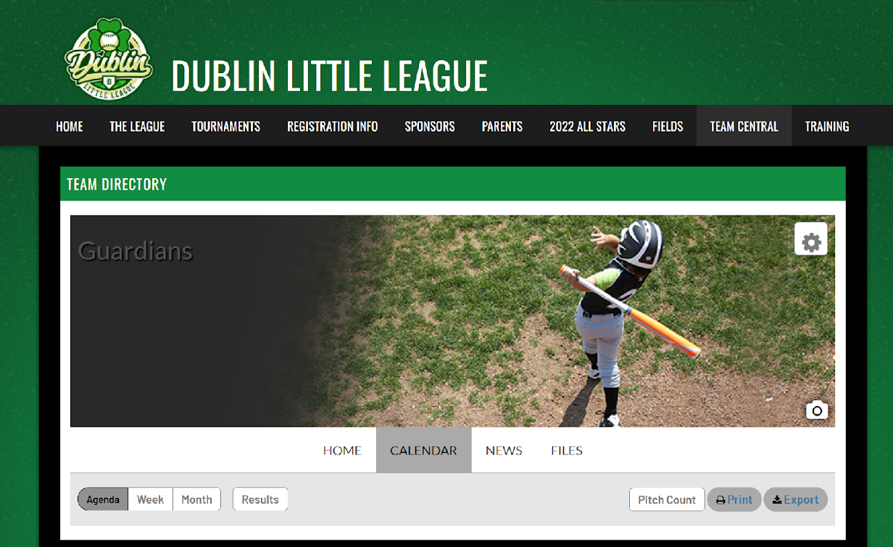
How to record results on Dublin Little League Website
6. Click on Results and then you will get a list of games to add the score to. You only need to add the scores. No other information is required.

